Slide 1
Digital Image Processing Lecture 1 Introduction & Fundamentals
Jin Qi
SICE, UESTC
2024

Slide 2

课程网站
https://github.com/jinqijinqi/image-processing-course

Slide 3
课程网站
相关资料及作业展示
记忆

Slide 4
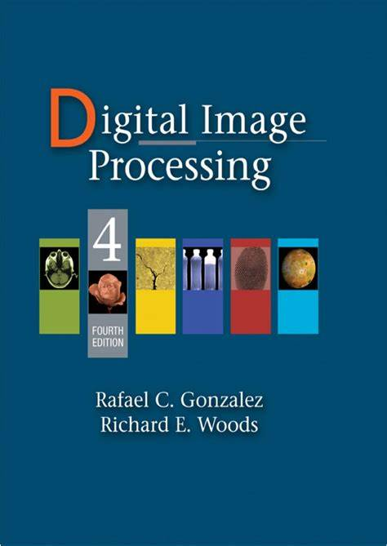
可选教材
Textbooks

Slide 5

为什么学图像处理？
智能体
图像/能量
行动

Slide 6
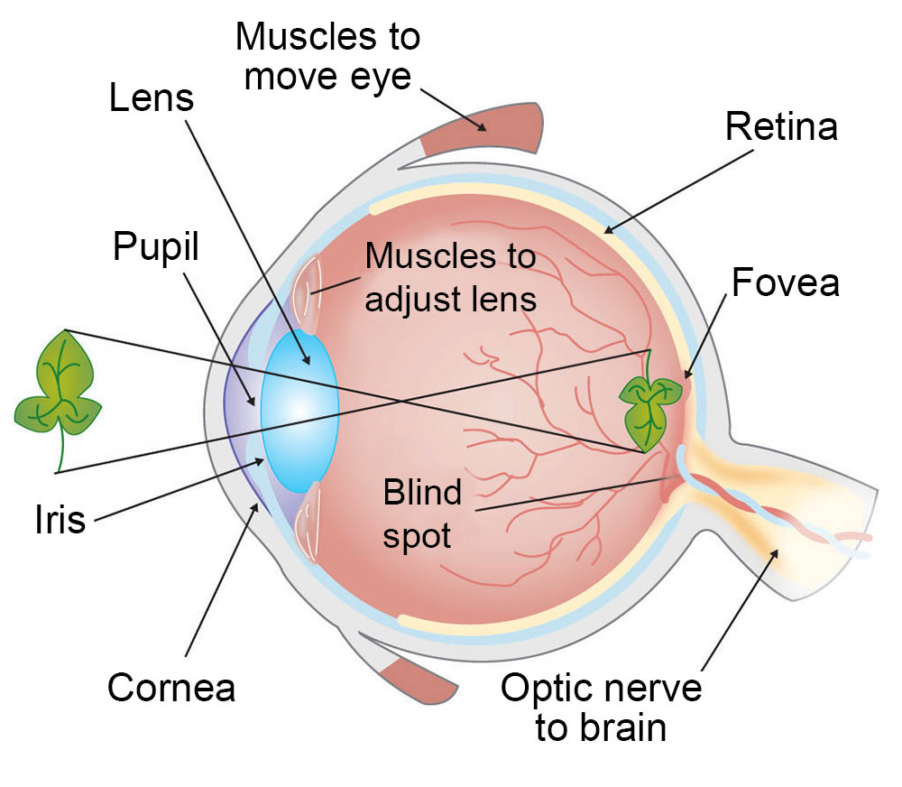
人眼成像原理

Slide 7
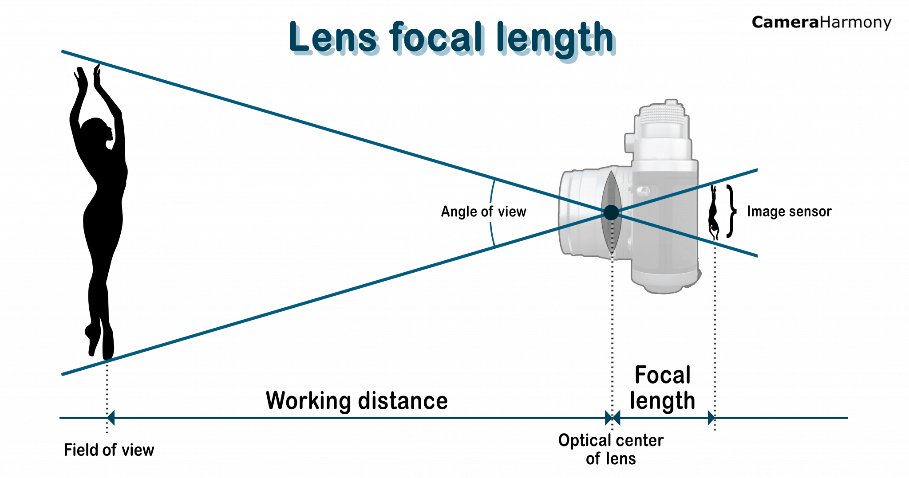
相机原理

Slide 8
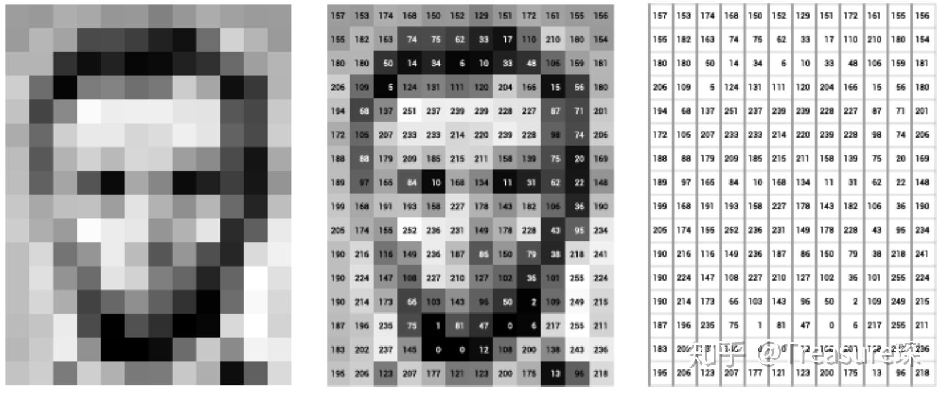
图像矩阵
图像处理
数学矩阵操作

Slide 9
主要内容
引言
基本概念
亮度变换及空间滤波
频域滤波
图像复原
彩色图像处理
小波变换
图像压缩
形态学处理
分割
特征抽取

Slide 10
考核
Grading
课堂小测： 10%
作业或课程设计: 60%
期末考试: 30%
Total: 100%

Slide 11
课堂小测
现场提交
不接受课后提交

Slide 12
作业
有的作业需要通过MATLAB编程实现。
作业报告形式提交，包含问题、解决方案、结果（以数字形式）。
它必须简洁又不失细节，还必须附加代码文件。

Slide 13
作业模板示例

Slide 15
作业评分评语
表达简洁独特 （非常、较、不、有创意）
内容完整性（完、不完整)
正确性 （完全，部分，不）
禁止直接抄袭，判定抄袭后，直接判定0分（是，不）

Slide 16
作业评分每一项占比
1．问题：
2．方案： (30%)
步骤：
3. 结果验证： (30%)
验证方法：
结果：
4. 结论: (10%)
5. 感悟: (10%)
6. 代码附录：代码文件 (20%)

Slide 17
作业每一部分评分标准
1．简洁独特性： （30%）
2. 正确性： （70%）

Slide 18
现场分组
5人一组，共6组，每组一个组长
全班两个课代表，负责总体事情，每人负责半个学期
互相交流讨论
组内作业互相检查、评分（评分按照评分标准），要有评分说明：正确性、简洁独特性、内容完整性、抄袭
组长将作业交课代表，课代表将作业给我并上传公示

Slide 19
Journals & Conferences in Image Processing
Journals:
— IEEE T IMAGE PROCESSING
— IEEE T MEDICAL IMAGING
— INTL J COMP. VISION
— IEEE T PATTERN ANALYSIS MACHINE INTELLIGENCE
— PATTERN RECOGNITION
— COMP. VISION AND IMAGE UNDERSTANDING
— IMAGE AND VISION COMPUTING
… …
Conferences:
— CVPR: Comp. Vision and Pattern Recognition
— ICCV: Intl Conf on Computer Vision
— ACM Multimedia
— ICIP
— SPIE
— ECCV: European Conf on Computer Vision
— CAIP: Intl Conf on Comp. Analysis of Images and Patterns
… …

Slide 20
Introduction
What is Digital Image Processing?
Digital Image
— a two-dimensional function
x and y are spatial coordinates
The amplitude of f is called intensity or gray level at the point (x, y)
Digital Image Processing
— process digital images by means of computer, it covers low-, mid-, and high-level processes
low-level: inputs and outputs are images
mid-level: outputs are attributes extracted from input images
high-level: an ensemble of recognition of individual objects
Pixel
— the elements of a digital image

Slide 21
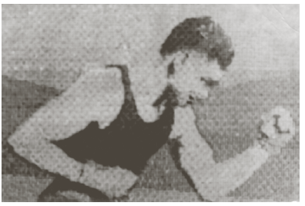
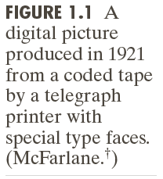
Origins of Digital Image Processing
Sent by submarine cable between London and New York, the transportation time was reduced to less than three hours from more than a week

Slide 22
Origins of Digital Image Processing

Slide 23
Sources for Images
Electromagnetic (EM) energy spectrum
Acoustic
Ultrasonic
Electronic
Synthetic images produced by computer

Slide 24
Electromagnetic (EM) energy spectrum
Major uses
Gamma-ray imaging: nuclear medicine and astronomical observations
X-rays: medical diagnostics, industry, and astronomy, etc.
Ultraviolet: lithography, industrial inspection, microscopy, lasers, biological imaging,
and astronomical observations
Visible and infrared bands: light microscopy, astronomy, remote sensing, industry,
and law enforcement
Microwave band: radar
Radio band: medicine (such as MRI) and astronomy

Slide 25
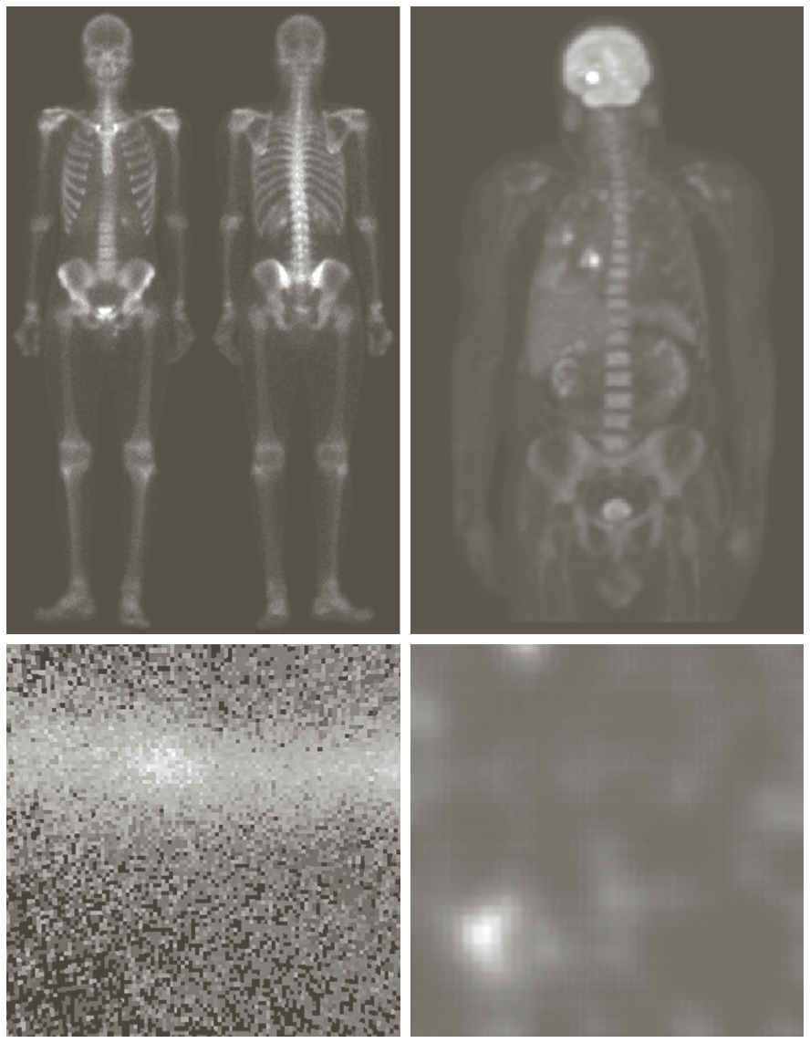

Examples: Gama-Ray Imaging

Slide 26
Examples: X-Ray Imaging

Slide 27
Examples: Ultraviolet Imaging

Slide 28
Examples: Light Microscopy Imaging

Slide 29
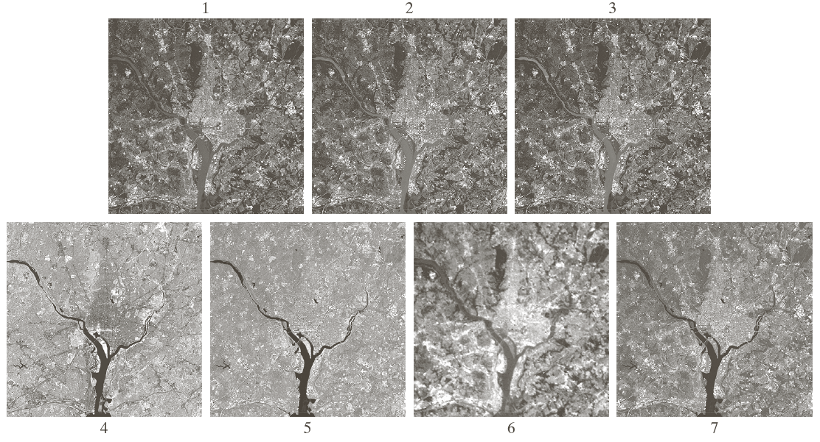
Examples: Visual and Infrared Imaging

Slide 30
Examples: Visual and Infrared Imaging

Slide 31
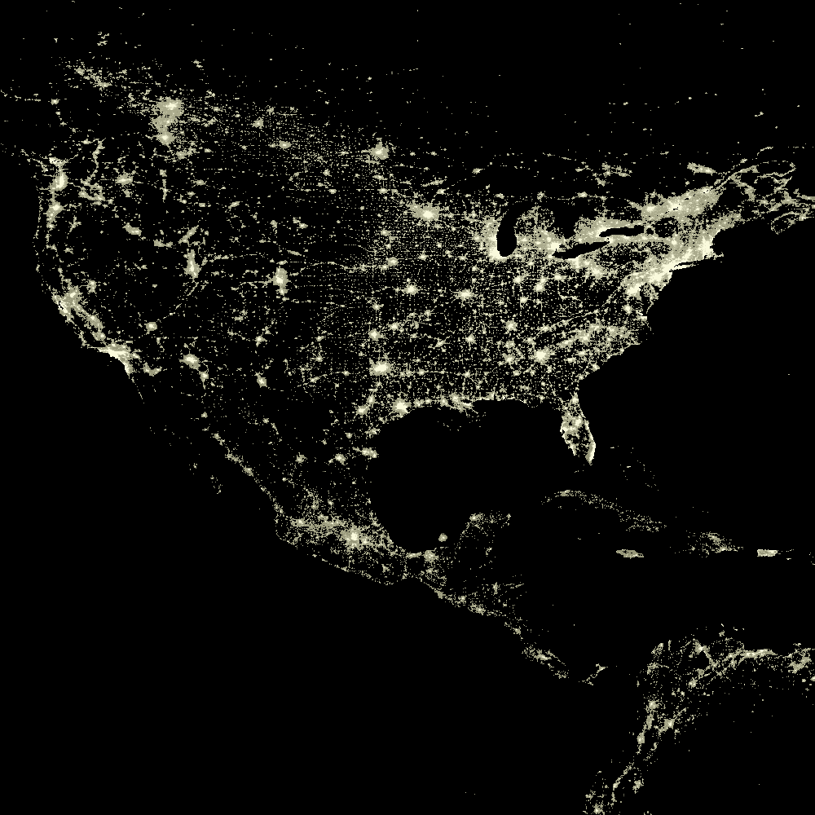
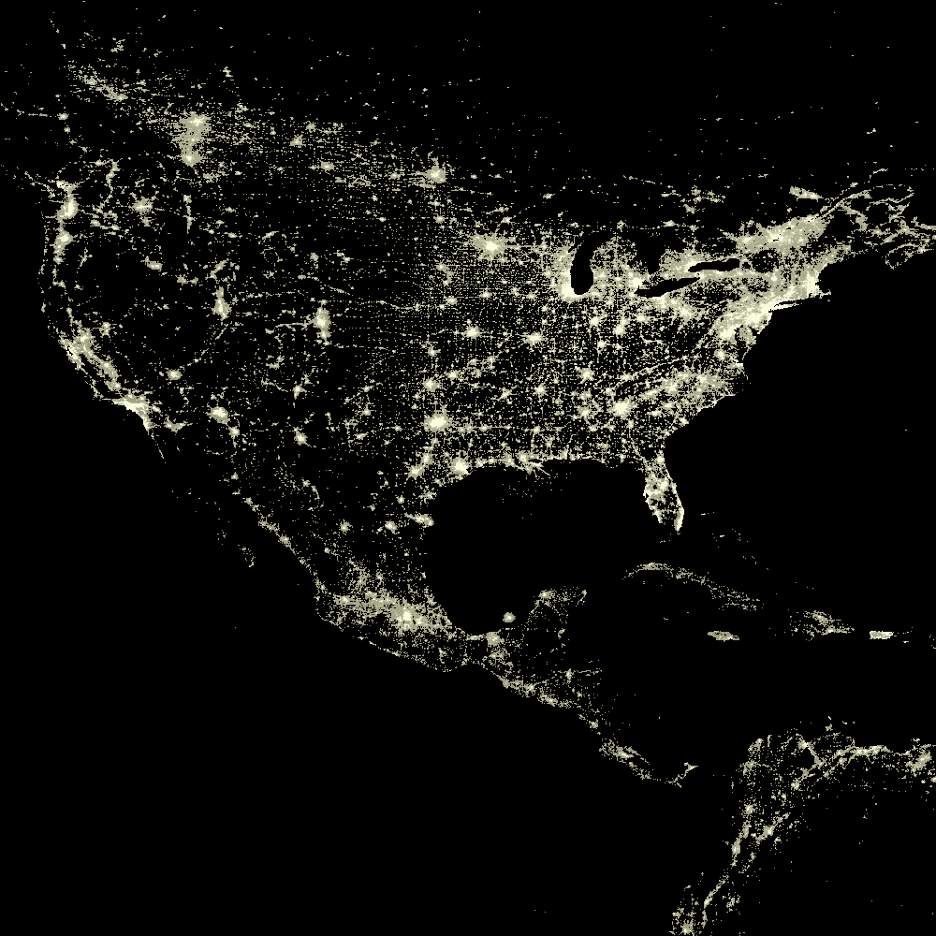
Examples: Infrared Satellite Imaging
USA 2003
USA 1993

Slide 32
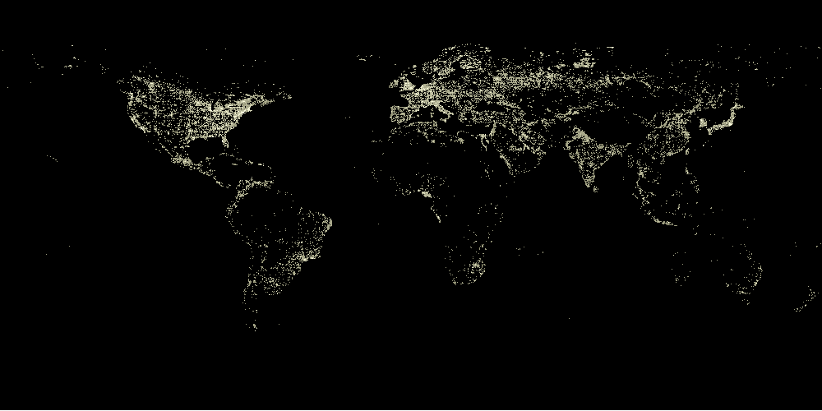
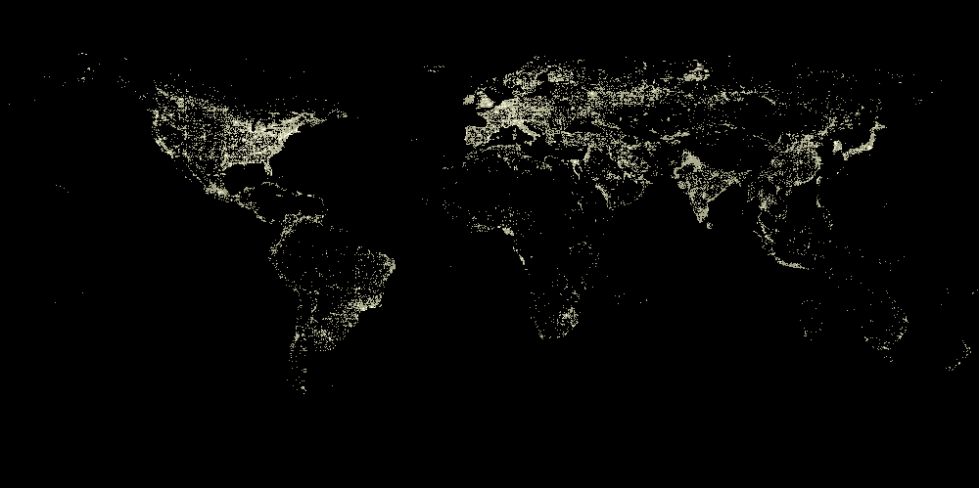
Examples: Infrared Satellite Imaging

Slide 33
Examples: Automated Visual Inspection

Slide 34
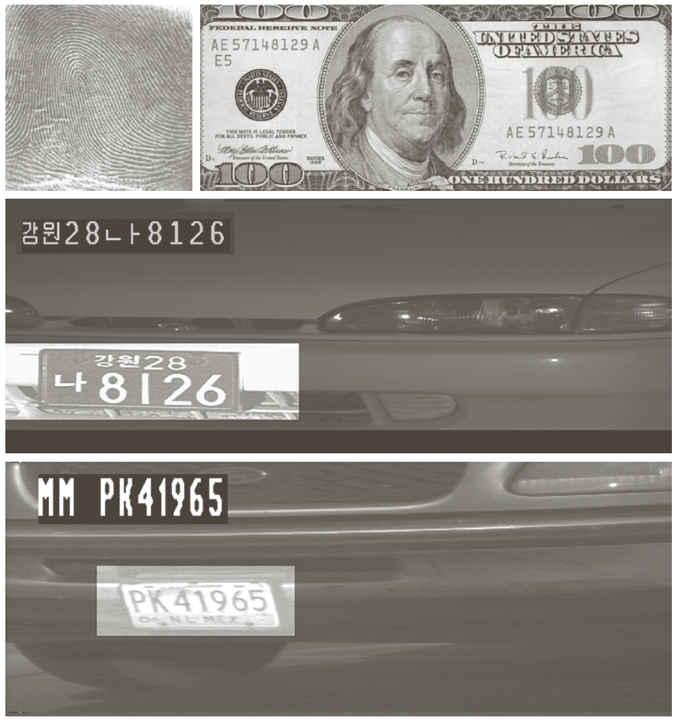
Examples: Automated Visual Inspection
Results of automated reading of the plate content by the system
The area in which the imaging system detected the plate

Slide 35
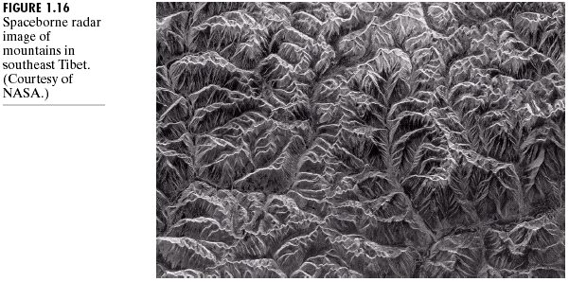
Example of Radar Image

Slide 36
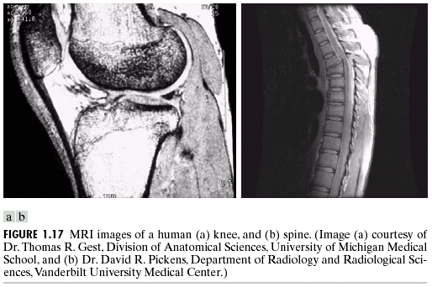
Examples: MRI (Radio Band)

Slide 37
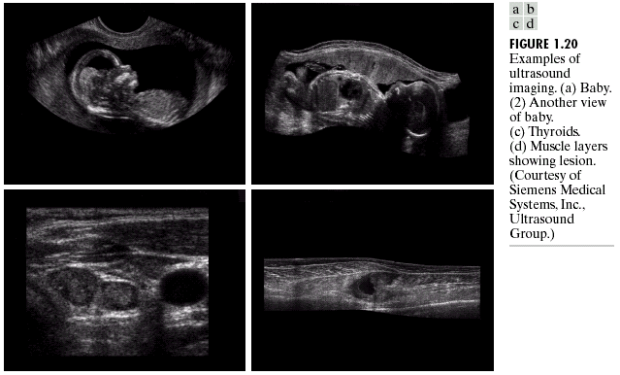
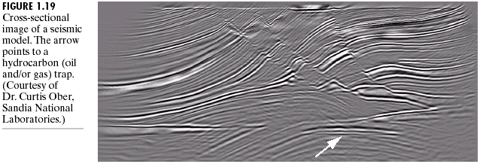
Examples: Ultrasound Imaging

Slide 38
Fundamental Steps in DIP
Extracting image components
Improving the appearance
Partition an image into its constituent parts or objects
Result is more suitable than the original
Represent image for computer processing

Slide 39
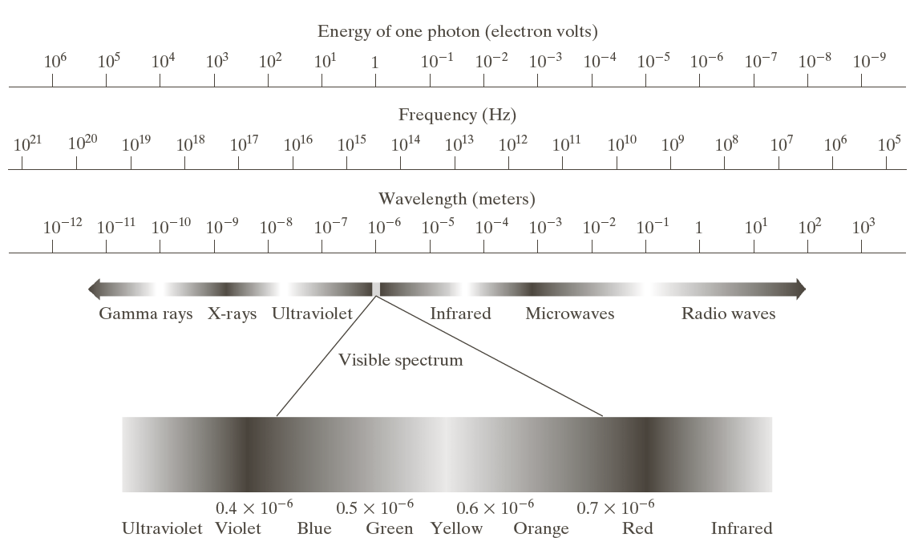
Light and EM Spectrum

Slide 40
Light and EM Spectrum
The colors that humans perceive in an object are determined by the nature of the light reflected from the object.
e.g. green objects reflect light with wavelengths primarily in the 500 to 570 nm range while absorbing most of the energy at other wavelength

Slide 41
Light and EM Spectrum
Monochromatic light: void of color
Intensity is the only attribute, from black to white
Monochromatic images are referred to as gray-scale images
Chromatic light bands: 0.43 to 0.79 um
The quality of a chromatic light source:
Radiance: total amount of energy
Luminance (lm): the amount of energy an observer perceives from a light source
Brightness: a subjective descriptor of light perception that is impossible to measure. It embodies the achromatic notion of intensity and one of the key factors in describing color sensation.

Slide 42
Image Acquisition
Transform illumination energy into digital images

Slide 43
Image Acquisition Using a Single Sensor

Slide 44
Image Acquisition Using Sensor Strips

Slide 45

Image Acquisition Process

Slide 46
A Simple Image Formation Model

Slide 47
Some Typical Ranges of illumination
Illumination
Lumen — A unit of light flow or luminous flux
Lumen per square meter (lm/m²) — The metric unit of measure for illuminance of a surface
On a clear day, the sun may produce in excess of 90,000 lm/m² of illumination on the surface of the Earth
On a cloudy day, the sun may produce less than 10,000 lm/m² of illumination on the surface of the Earth
On a clear evening, the moon yields about 0.1 lm/m² of illumination
The typical illumination level in a commercial office is about 1000 lm/m²

Slide 48
Some Typical Ranges of Reflectance
Reflectance
0.01 for black velvet
0.65 for stainless steel
0.80 for flat-white wall paint
0.90 for silver-plated metal
0.93 for snow

Slide 49
Image Sampling and Quantization
Digitizing the coordinate values
Digitizing the amplitude values

Slide 50
Image Sampling and Quantization

Slide 51
Representing Digital Images

Slide 52
Representing Digital Images
The representation of an M×N numerical array as

Slide 53
Representing Digital Images
The representation of an M×N numerical array as

Slide 54
Representing Digital Images
The representation of an M×N numerical array in MATLAB

Slide 55
Representing Digital Images
Discrete intensity interval [0, L-1], L=2^{k}
The number b of bits required to store a M × N digitized image
b = M × N × k

Slide 56
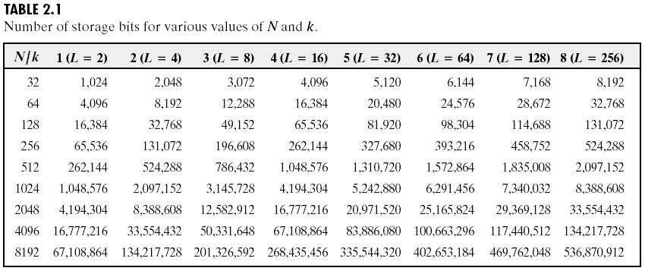
Representing Digital Images

Slide 57
Spatial and Intensity Resolution
Spatial resolution
— A measure of the smallest discernible detail in an image
— stated with line pairs per unit distance, dots (pixels) per unit distance, dots per inch (dpi)
Intensity resolution
— The smallest discernible change in intensity level
— stated with 8 bits, 12 bits, 16 bits, etc.

Slide 58
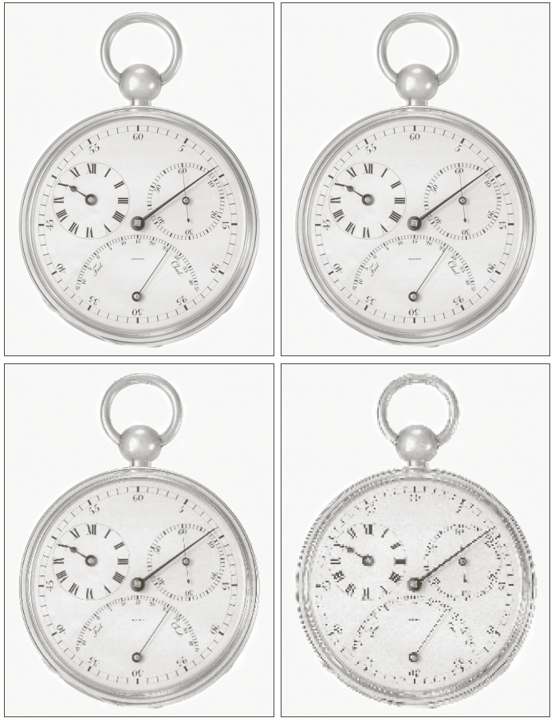
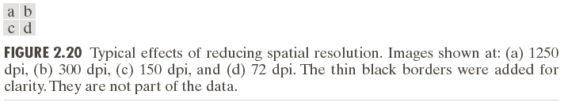
Spatial and Intensity Resolution

Slide 59
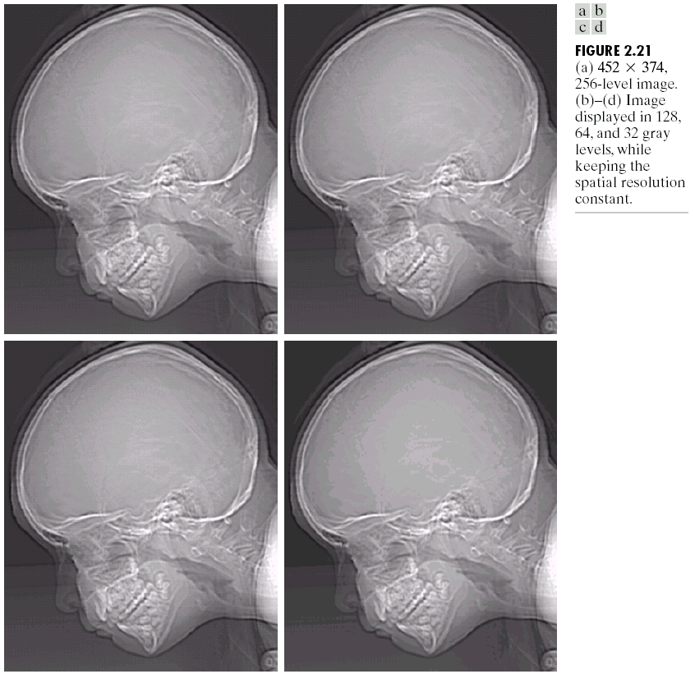
Spatial and Intensity Resolution

Slide 60
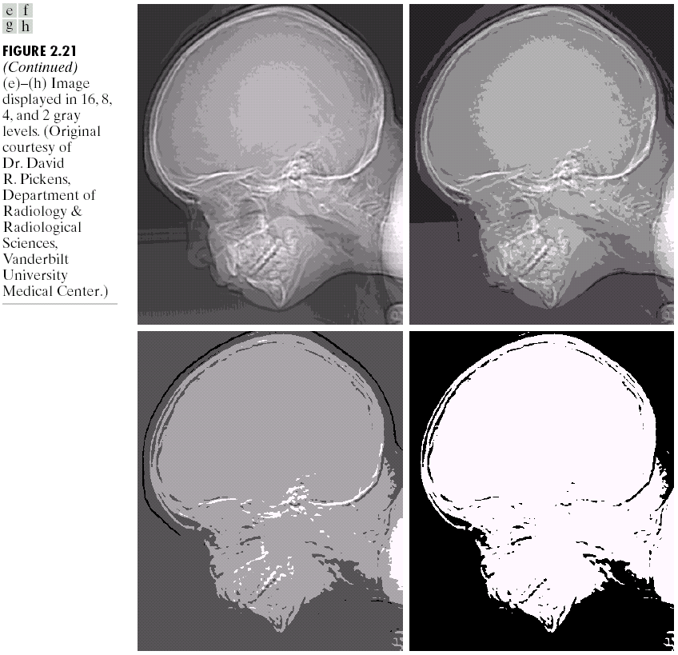
Spatial and Intensity Resolution

Slide 61
Image Interpolation
Interpolation — Process of using known data to estimate unknown values
e.g., zooming, shrinking, rotating, and geometric correction
Interpolation (sometimes called resampling) — an imaging method to increase (or decrease) the number of pixels in a digital image.
Some digital cameras use interpolation to produce a larger image than the sensor captured or to create digital zoom
http://www.dpreview.com/learn/?/key=interpolation

Slide 62
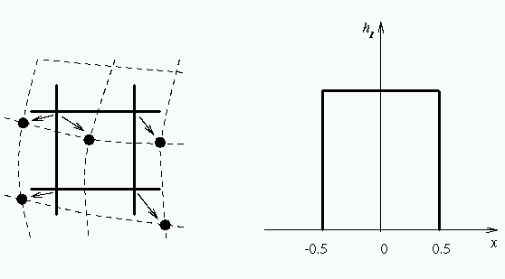
Image Interpolation: Nearest Neighbor Interpolation
f₁(x₂,y₂) =
f(round(x₂), round(y₂))
=f(x₁,y₁)
f(x₁,y₁)
f₁(x₃,y₃) =
f(round(x₃), round(y₃))
=f(x₁,y₁)

Slide 63
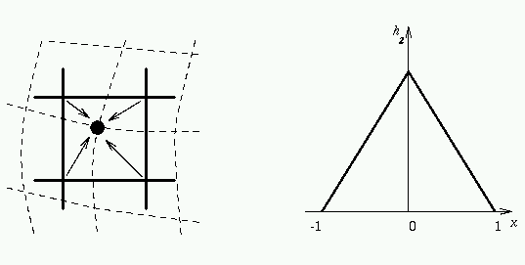
Image Interpolation: Bilinear Interpolation
(x,y)

Slide 64
Image Interpolation: Bicubic Interpolation
The intensity value assigned to point (x,y) is obtained by the following equation
The sixteen coefficients are determined by using the sixteen nearest neighbors.
http://en.wikipedia.org/wiki/Bicubic_interpolation

Slide 65
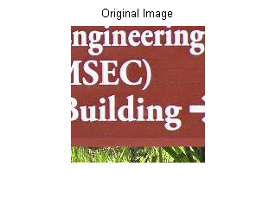
Examples: Interpolation

Slide 66
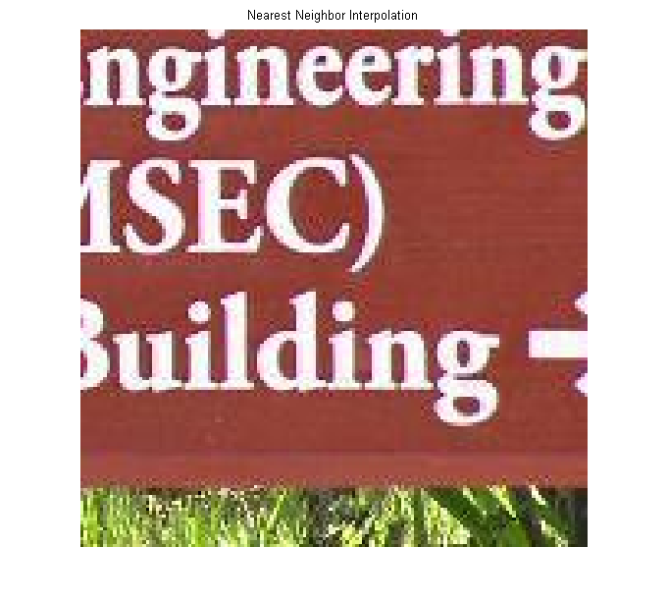
Examples: Interpolation

Slide 67

Examples: Interpolation

Slide 68

Examples: Interpolation

Slide 69
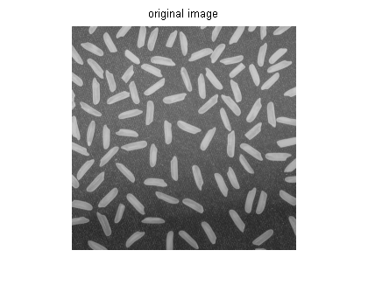
Examples: Interpolation

Slide 70
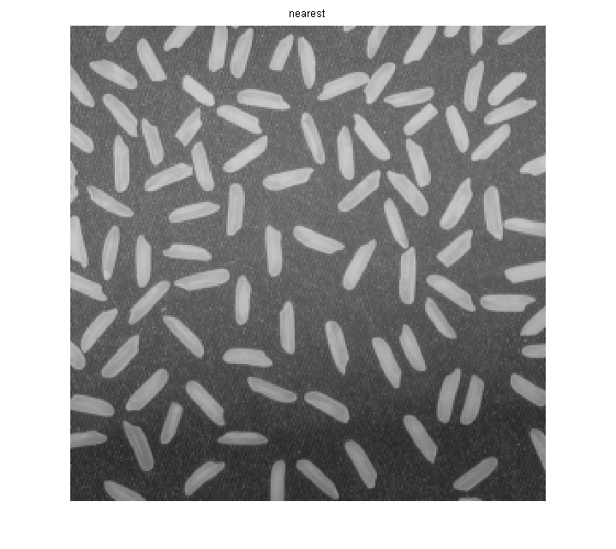
Examples: Interpolation

Slide 71
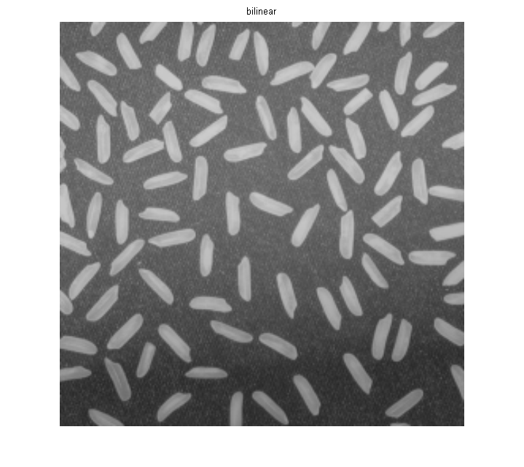
Examples: Interpolation

Slide 72

Examples: Interpolation

Slide 73
Basic Relationships Between Pixels
Neighborhood
Adjacency
Connectivity
Paths
Regions and boundaries

Slide 74
Basic Relationships Between Pixels
Neighbors of a pixel p at coordinates (x,y)
4-neighbors of p, denoted by N₄(p):
(x-1, y), (x+1, y), (x,y-1), and (x, y+1).
4 diagonal neighbors of p, denoted by N_{D}(p):
(x-1, y-1), (x+1, y+1), (x+1,y-1), and (x-1, y+1).
8 neighbors of p, denoted N₈(p)
N₈(p) = N₄(p) U N_{D}(p)

Slide 75
Basic Relationships Between Pixels
Adjacency
Let V be the set of intensity values
4-adjacency: Two pixels p and q with values from V are 4-adjacent if q is in the set N₄(p).
8-adjacency: Two pixels p and q with values from V are 8-adjacent if q is in the set N₈(p).

Slide 76
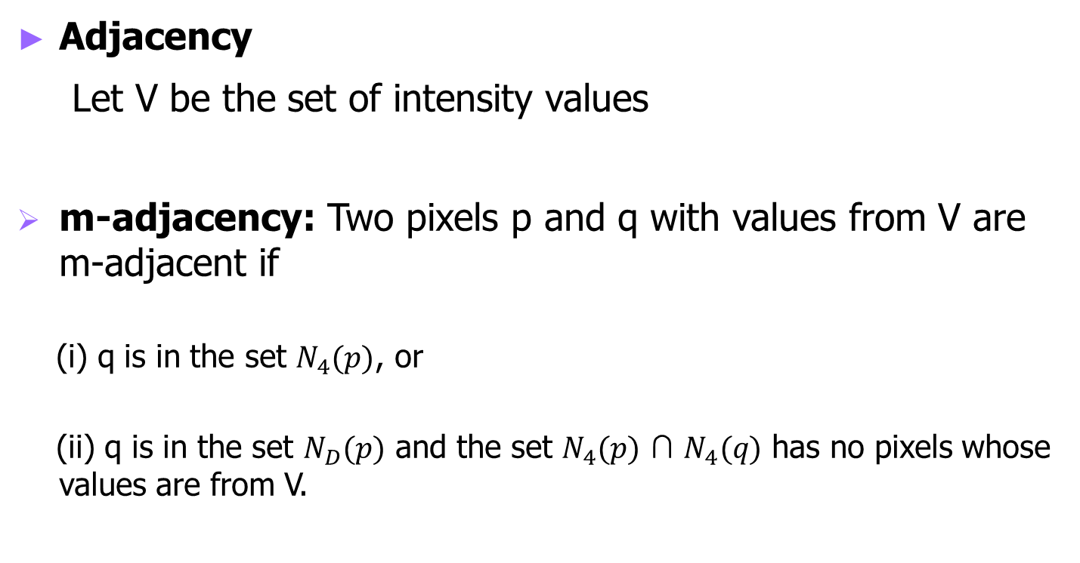
Basic Relationships Between Pixels
Adjacency
Let V be the set of intensity values
m-adjacency: Two pixels p and q with values from V are m-adjacent if
(i) q is in the set $N_{4}(p)$, or
(ii) q is in the set $N_{D}(p)$ and the set $N_{4}(p)$ ∩ $N_{4}(q)$ has no pixels whose values are from V.

Slide 77
Basic Relationships Between Pixels
Path
A (digital) path (or curve) from pixel p with coordinates (x₀, y₀) to pixel q with coordinates (x_{n}, y_{n}) is a sequence of distinct pixels with coordinates
(x₀, y₀), (x₁, y₁), …, (x_{n}, y_{n})
Where (x_{i}, y_{i}) and (x_{i-1}, y_{i-1}) are adjacent for 1 ≤ i ≤ n.
Here n is the length of the path.
If (x₀, y₀) = (x_{n}, y_{n}), the path is closed path.
We can define 4-, 8-, and m-paths based on the type of adjacency used.

Slide 78
Examples: Adjacency and Path
V = {1, 2}
0 1 1 0 1 1 0 1 1
0 2 0 0 2 0 0 2 0
0 0 1 0 0 1 0 0 1

Slide 79
Examples: Adjacency and Path
V = {1, 2}
0 1 1 0 1 1 0 1 1
0 2 0 0 2 0 0 2 0
0 0 1 0 0 1 0 0 1
8-adjacent

Slide 80
Examples: Adjacency and Path
V = {1, 2}
0 1 1 0 1 1 0 1 1
0 2 0 0 2 0 0 2 0
0 0 1 0 0 1 0 0 1
8-adjacent
m-adjacent

Slide 81
Examples: Adjacency and Path
V = {1, 2}
01,1 11,2 11,3 0 1 1 0 1 1
02,1 22,2 02,3 0 2 0 0 2 0
03,1 03,2 13,3 0 0 1 0 0 1
8-adjacent
m-adjacent
The 8-path from (1,3) to (3,3):
(1,3), (1,2), (2,2), (3,3)
(1,3), (2,2), (3,3)
The m-path from (1,3) to (3,3):
(1,3), (1,2), (2,2), (3,3)

Slide 82
Basic Relationships Between Pixels
Connected in S
Let S represent a subset of pixels in an image. Two pixels p with coordinates (x₀, y₀) and q with coordinates (x_{n}, y_{n}) are said to be connected in S if there exists a path
(x₀, y₀), (x₁, y₁), …, (x_{n}, y_{n})
Where

Slide 83
Basic Relationships Between Pixels
Let S represent a subset of pixels in an image
For every pixel p in S, the set of pixels in S that are connected to p is called a connected component of S.
If S has only one connected component, then S is called Connected Set.
We call R a region of the image if R is a connected set
Two regions, R_{i} and R_{j} are said to be adjacent if their union forms a connected set.
Regions that are not to be adjacent are said to be disjoint.

Slide 84
Basic Relationships Between Pixels
Boundary (or border)
The boundary of the region R is the set of pixels in the region that have one or more neighbors that are not in R.
If R happens to be an entire image, then its boundary is defined as the set of pixels in the first and last rows and columns of the image.
Foreground and background
An image contains K disjoint regions, R_{k}, k = 1, 2, …, K. Let R_{u} denote the union of all the K regions, and let (R_{u})^{c} denote its complement.
All the points in R_{u} is called foreground;
All the points in (R_{u})^{c} is called background.

Slide 85
Question 1
In the following arrangement of pixels, are the two regions (of 1s) adjacent? (if 8-adjacency is used)
1 1 1
1 0 1
0 1 0
0 0 1
1 1 1
1 1 1
Region 1
Region 2

Slide 86
Question 2
In the following arrangement of pixels, are the two parts (of 1s) adjacent? (if 4-adjacency is used)
1 1 1
1 0 1
0 1 0
0 0 1
1 1 1
1 1 1
Part 1
Part 2

Slide 87
In the following arrangement of pixels, the two regions (of 1s) are disjoint (if 4-adjacency is used)
1 1 1
1 0 1
0 1 0
0 0 1
1 1 1
1 1 1
Region 1
Region 2

Slide 88
In the following arrangement of pixels, the two regions (of 1s) are disjoint (if 4-adjacency is used)
1 1 1
1 0 1
0 1 0
0 0 1
1 1 1
1 1 1
foreground
background

Slide 89
Question 3
In the following arrangement of pixels, the circled point is part of the boundary of the 1-valued pixels if 8-adjacency is used, true or false?
0 0 0 0 0
0 1 1 0 0
0 1 1 0 0
0 1 1 1 0
0 1 1 1 0
0 0 0 0 0

Slide 90
Question 4
In the following arrangement of pixels, the circled point is part of the boundary of the 1-valued pixels if 4-adjacency is used, true or false?
0 0 0 0 0
0 1 1 0 0
0 1 1 0 0
0 1 1 1 0
0 1 1 1 0
0 0 0 0 0

Slide 91
Distance Measures
Given pixels p, q and z with coordinates (x, y), (s, t), (u, v) respectively, the distance function D has following properties:
D(p, q) ≥ 0 [D(p, q) = 0, iff p = q]
D(p, q) = D(q, p)
D(p, z) ≤ D(p, q) + D(q, z)

Slide 92
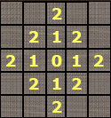
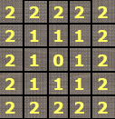
Distance Measures
The following are the different Distance measures:
a. Euclidean Distance :
D_{e}(p, q) = [(x-s)² + (y-t)²]^{1/2}
b. City Block Distance:
D₄(p, q) = |x-s| + |y-t|
c. Chess Board Distance:
D₈(p, q) = max(|x-s|, |y-t|)

Slide 93
Question 5
In the following arrangement of pixels, what’s the value of the chessboard distance between the circled two points?
0 0 0 0 0
0 0 1 1 0
0 1 1 0 0
0 1 0 0 0
0 0 0 0 0
0 0 0 0 0

Slide 94
Question 6
In the following arrangement of pixels, what’s the value of the city-block distance between the circled two points?
0 0 0 0 0
0 0 1 1 0
0 1 1 0 0
0 1 0 0 0
0 0 0 0 0
0 0 0 0 0

Slide 95
Question 7
In the following arrangement of pixels, what’s the value of the length of the m-path between the circled two points?
0 0 0 0 0
0 0 1 1 0
0 1 1 0 0
0 1 0 0 0
0 0 0 0 0
0 0 0 0 0

Slide 96
Question 8
In the following arrangement of pixels, what’s the value of the length of the m-path between the circled two points?
0 0 0 0 0
0 0 1 1 0
0 0 1 0 0
0 1 0 0 0
0 0 0 0 0
0 0 0 0 0

Slide 97
Introduction to Mathematical Operations in DIP
Array vs. Matrix Operation
Array product
operator
Array product
Matrix product
operator
Matrix product

Slide 98
Introduction to Mathematical Operations in DIP
Linear vs. Nonlinear Operation
H is said to be a linear operator;
H is said to be a nonlinear operator if it does not meet the above qualification.
Additivity
Homogeneity

Slide 99
Arithmetic Operations
Arithmetic operations between images are array operations. The four arithmetic operations are denoted as
s(x,y) = f(x,y) + g(x,y)
d(x,y) = f(x,y) – g(x,y)
p(x,y) = f(x,y) × g(x,y)
v(x,y) = f(x,y) ÷ g(x,y)

Slide 100
Example: Addition of Noisy Images for Noise Reduction
Noiseless image: f(x,y)
Noise: n(x,y) (at every pair of coordinates (x,y), the noise is uncorrelated and has zero average value)
Corrupted image: g(x,y)
g(x,y) = f(x,y) + n(x,y)
Reducing the noise by adding a set of noisy images, {g_{i}(x,y)}

Slide 101
Example: Addition of Noisy Images for Noise Reduction

Slide 102
Example: Addition of Noisy Images for Noise Reduction
In astronomy, imaging under very low light levels frequently causes sensor noise to render single images virtually useless for analysis.
In astronomical observations, similar sensors for noise reduction by observing the same scene over long periods of time. Image averaging is then used to reduce the noise.

Slide 103
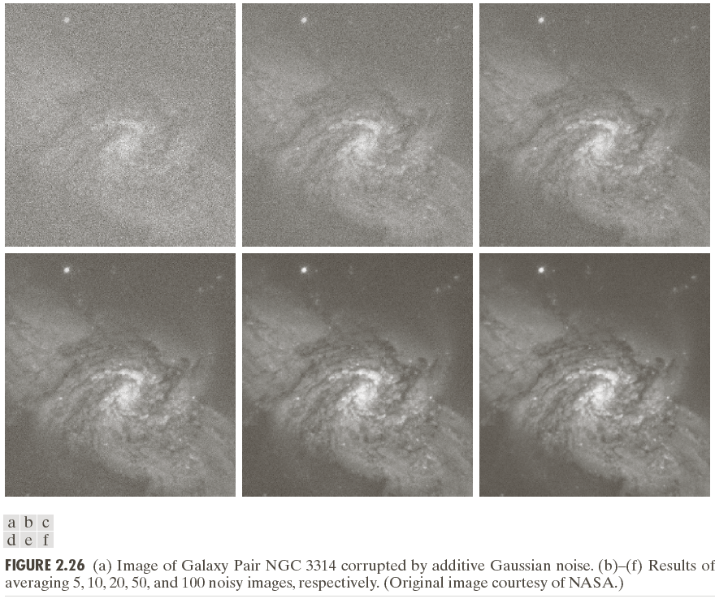

Slide 104
An Example of Image Subtraction: Mask Mode Radiography
Mask h(x,y): an X-ray image of a region of a patient’s body
Live images f(x,y): X-ray images captured at TV rates after injection of the contrast medium
Enhanced detail g(x,y)
g(x,y) = f(x,y) - h(x,y)
The procedure gives a movie showing how the contrast medium propagates through the various arteries in the area being observed.

Slide 105
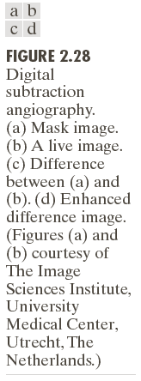

Slide 106
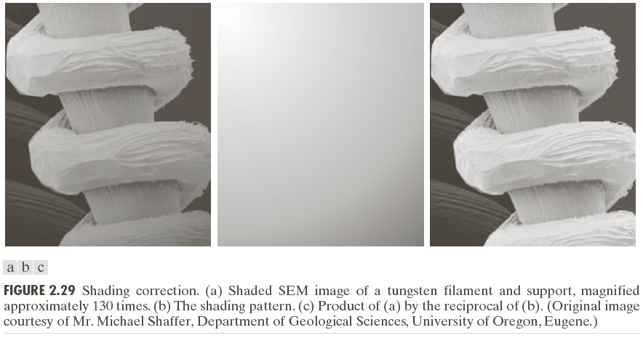
An Example of Image Multiplication

Slide 107
Set and Logical Operations

Slide 108
Set and Logical Operations
Let A be the elements of a gray-scale image
The elements of A are triplets of the form (x, y, z), where x and y are spatial coordinates and z denotes the intensity at the point (x, y).
The complement of A is denoted A^{c}

Slide 109
Set and Logical Operations
The union of two gray-scale images (sets) A and B is defined as the set

Slide 110
Set and Logical Operations

Slide 111
Set and Logical Operations

Slide 112
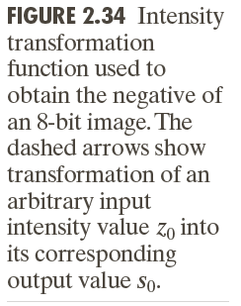
Spatial Operations
Single-pixel operations
Alter the values of an image’s pixels based on the intensity.
e.g.,

Slide 113
Spatial Operations
Neighborhood operations
The value of this pixel is determined by a specified operation involving the pixels in the input image with coordinates in S_{xy}

Slide 114
Spatial Operations
Neighborhood operations

Slide 115
Geometric Spatial Transformations
Geometric transformation (rubber-sheet transformation)
— A spatial transformation of coordinates
— intensity interpolation that assigns intensity values to the spatially transformed pixels.
Affine transform

Slide 117
Intensity Assignment
Forward Mapping
It’s possible that two or more pixels can be transformed to the same location in the output image.
Inverse Mapping
The nearest input pixels to determine the intensity of the output pixel value.
Inverse mappings are more efficient to implement than forward mappings.

Slide 118
Example: Image Rotation and Intensity Interpolation

Slide 119
Image Registration
Input and output images are available but the transformation function is unknown.
Goal: estimate the transformation function and use it to register the two images.
One of the principal approaches for image registration is to use tie points (also called control points)
The corresponding points are known precisely in the input and output (reference) images.

Slide 120
Image Registration
A simple model based on bilinear approximation:

Slide 121
Image Registration

Slide 122
Image Transform
A particularly important class of 2-D linear transforms, denoted T(u, v)

Slide 123
Image Transform
Given T(u, v), the original image f(x, y) can be recoverd using the inverse tranformation of T(u, v).

Slide 124
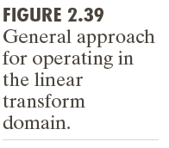
Image Transform

Slide 125
Example: Image Denoising by Using DCT Transform

Slide 126
Forward Transform Kernel

Slide 127
The Kernels for 2-D Fourier Transform

Slide 128
2-D Fourier Transform

Slide 129
Probabilistic Methods

Slide 130
Probabilistic Methods

Slide 131
Example: Comparison of Standard Deviation Values

